Slide 1


Optimising Assets (Sample Outputs)

Slide 2

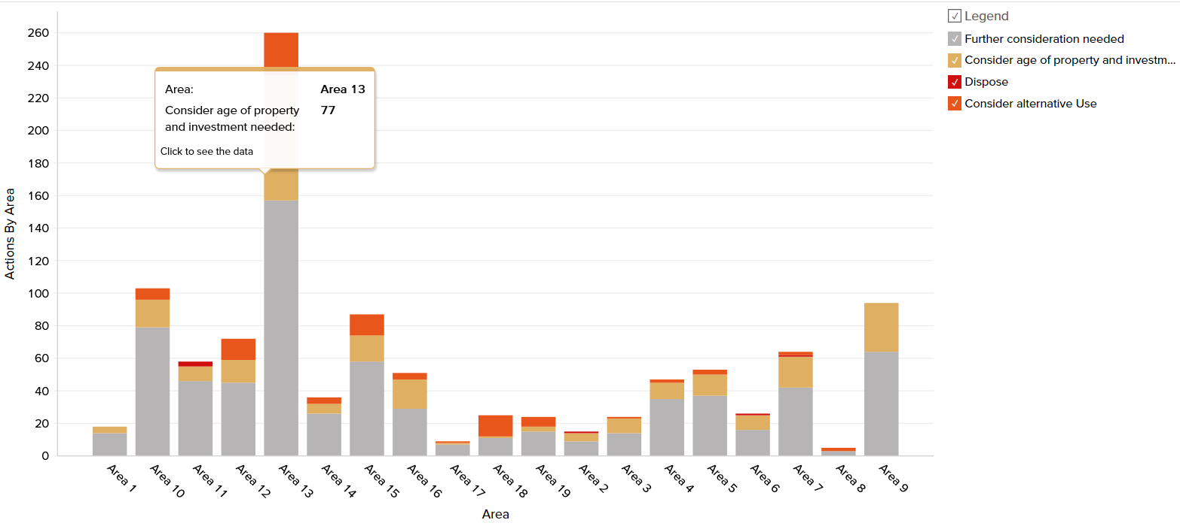
Optimising Assets – Sample Outputs
© 2017 i4Housing All Rights Reserved

Slide 3
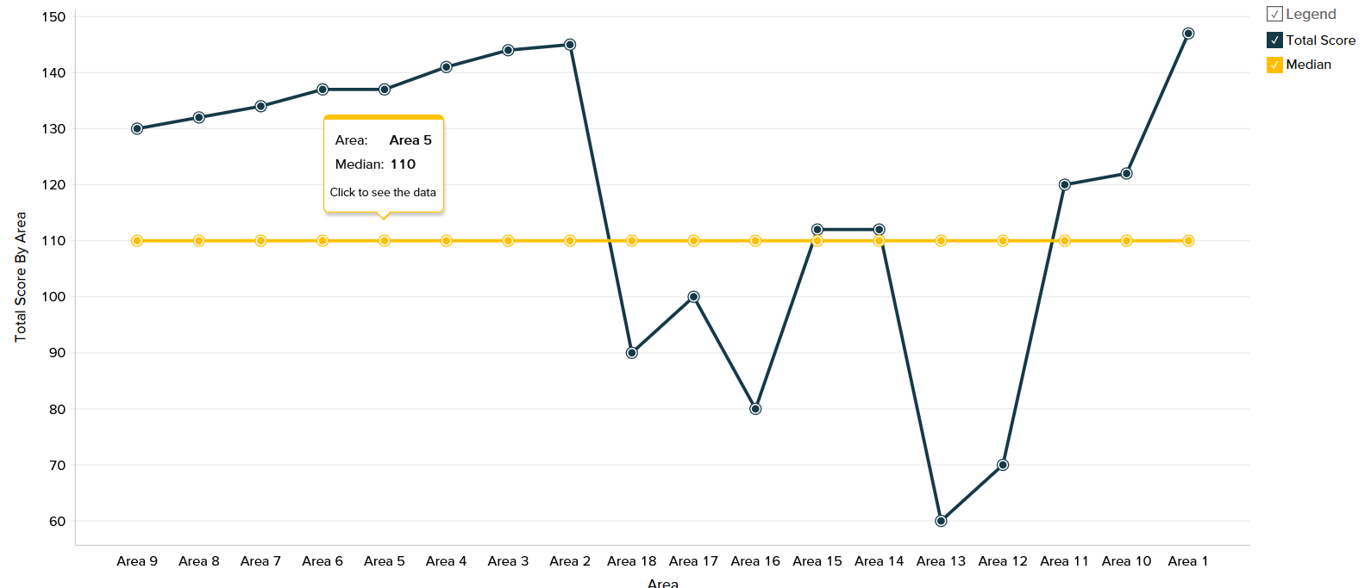
Optimising Assets – Sample Outputs
© 2017 i4Housing All Rights Reserved

Slide 4
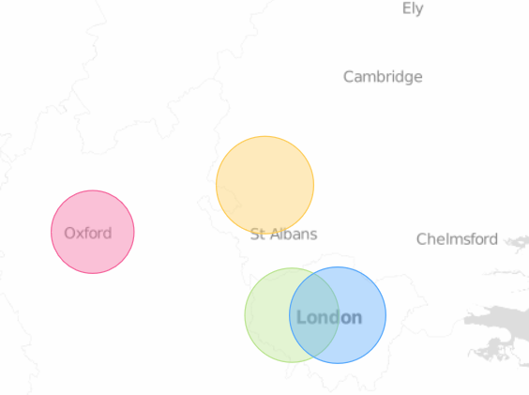
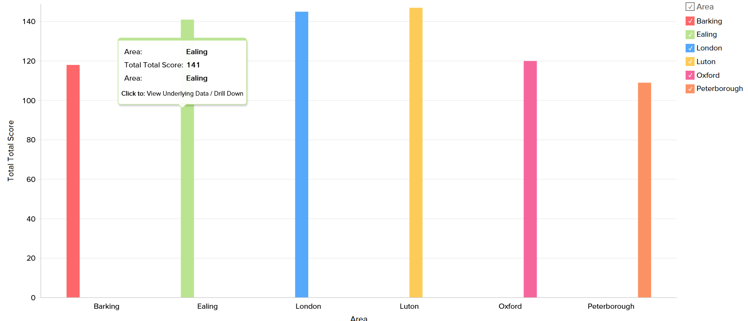
Optimising Assets – Sample Outputs
© 2017 i4Housing All Rights Reserved

Slide 5
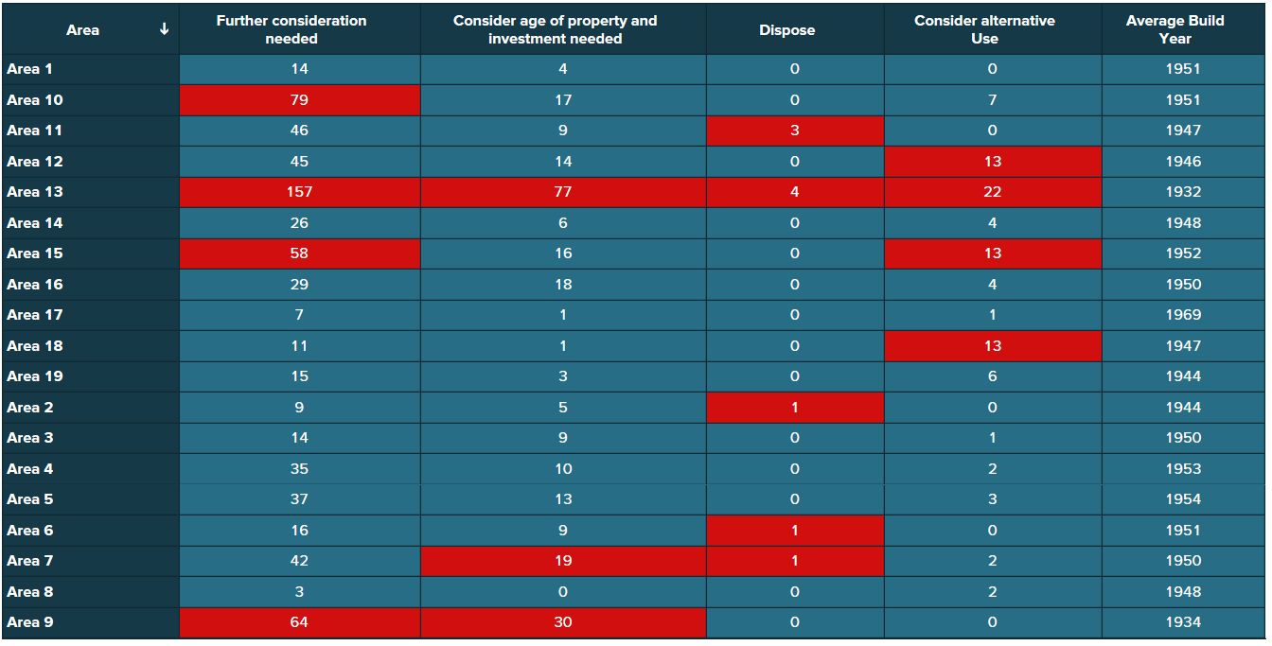
Optimising Assets – Sample Outputs
© 2017 i4Housing All Rights Reserved

